Slide 1

UCSD Assignment
Vishwakarma Institute of Information Technology Department of Information Technology
SY IT B3 Subject: User Centric Software Design
Teacher: Mahesh Bhandari
Sr. NO. | NAME | ROLL NO. | PRN
1 | Anushka Kadam | 232070 | 22311767
2 | Shreya Patil | 232072 | 22311874
3 | Amrin Attar | 232075 | 22420139

Slide 2

Intelligent Movie Recommendation and Review Aggregation Website

Slide 3

Introduction
An intelligent AI-powered assistant designed to understand natural language inputs, curate movie suggestions tailored to user preferences, and analyze reviews to provide insightful summaries. It leverages advanced technologies like LLMs and vector search for precise and engaging interactions.
Centralized platform for movie discovery.
Personalized recommendations based on user inputs (mood, genre, etc.).
Review aggregation from IMDb, Rotten Tomatoes, etc.

Slide 4
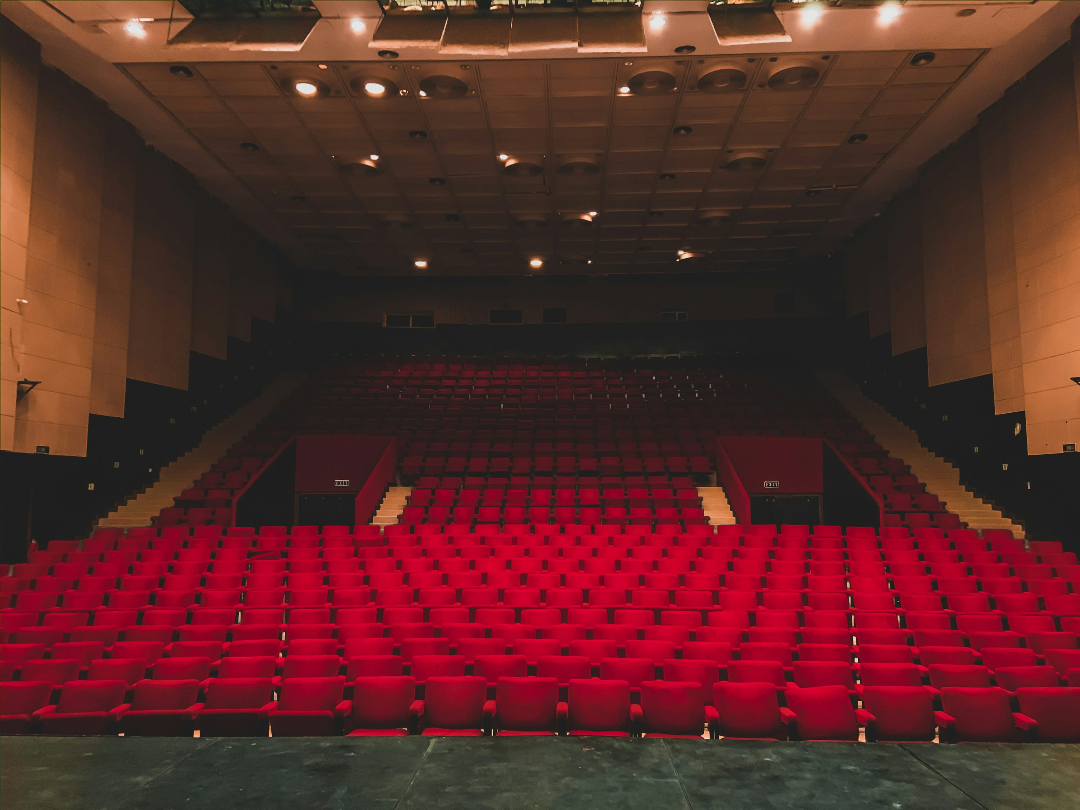
Identifying Stakeholders
Developers:
Technical team building and maintaining the chatbot.
Content Providers:
Platforms like IMDb and Rotten Tomatoes supplying data.
Advertisers:
Sponsors targeting the chatbot's audience.
Business Owners:
Companies using the chatbot to boost engagement.
End Users:
Movie Enthusiasts seeking tailored suggestions and reviews

Slide 5
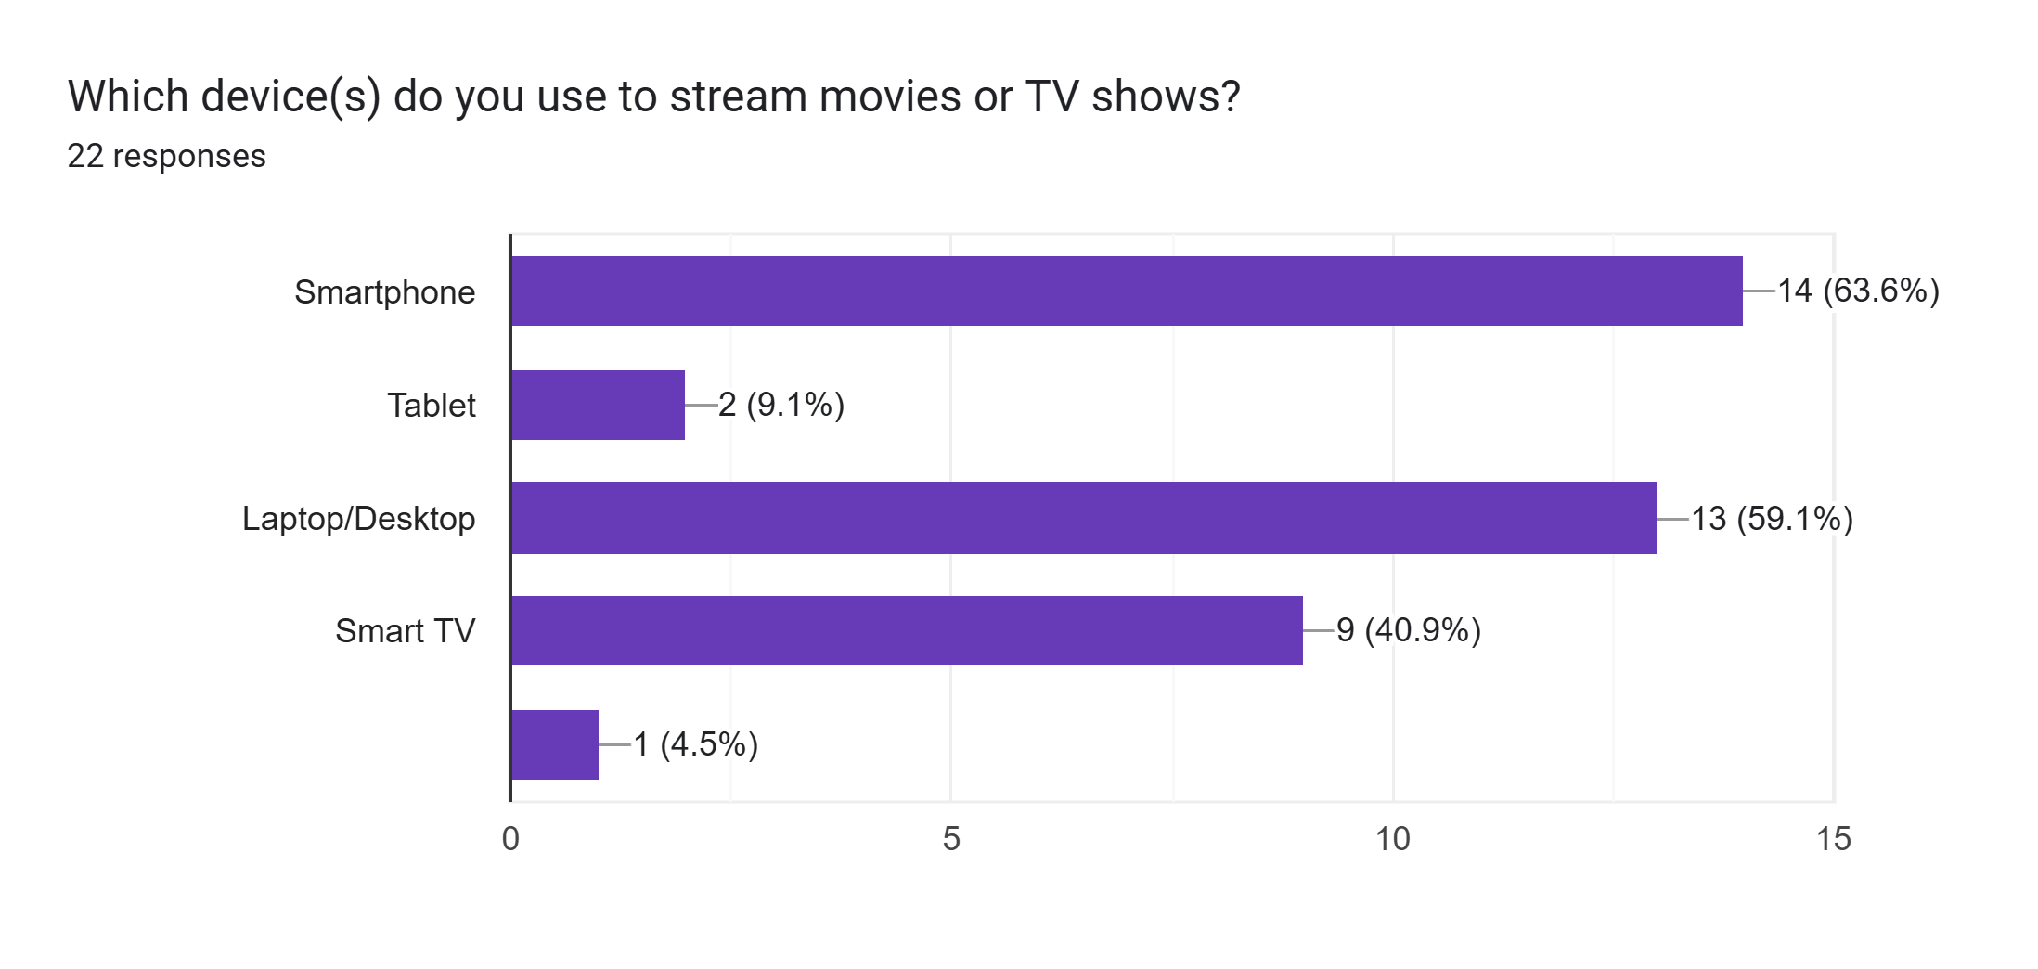
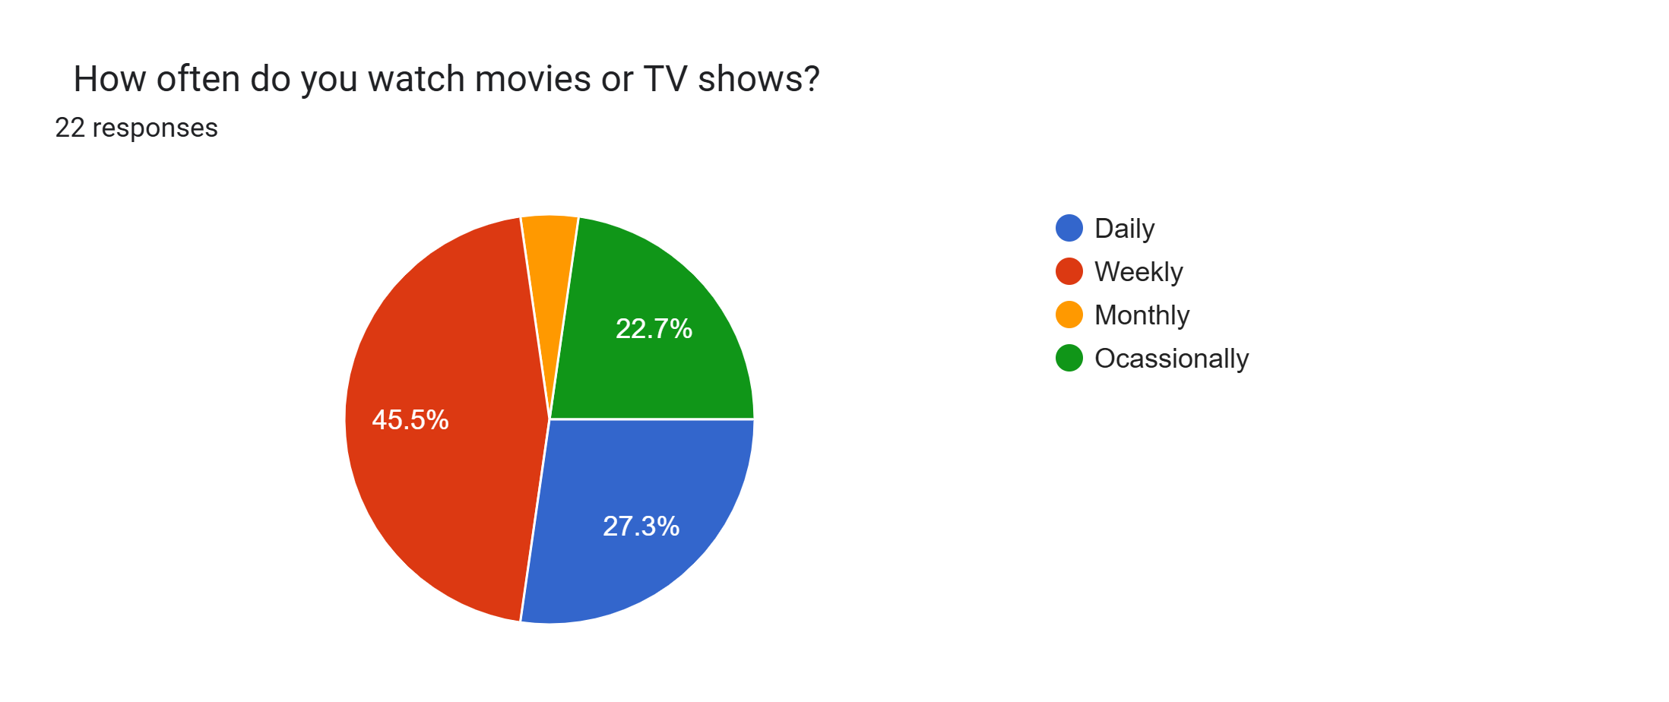
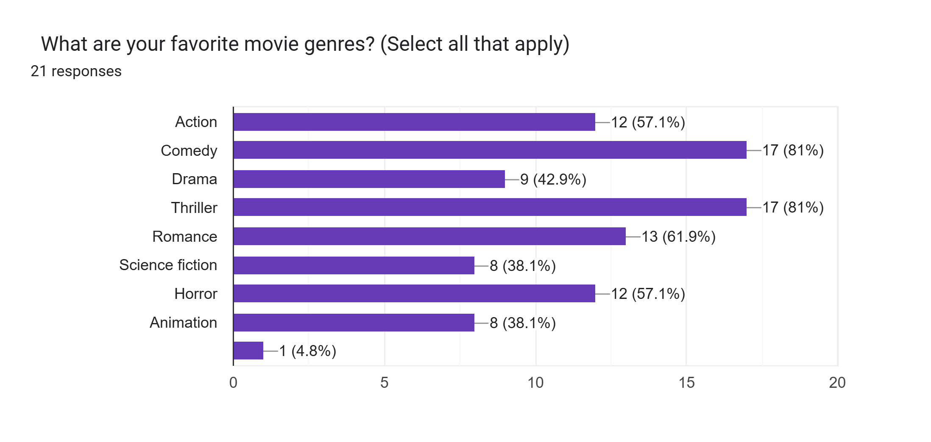
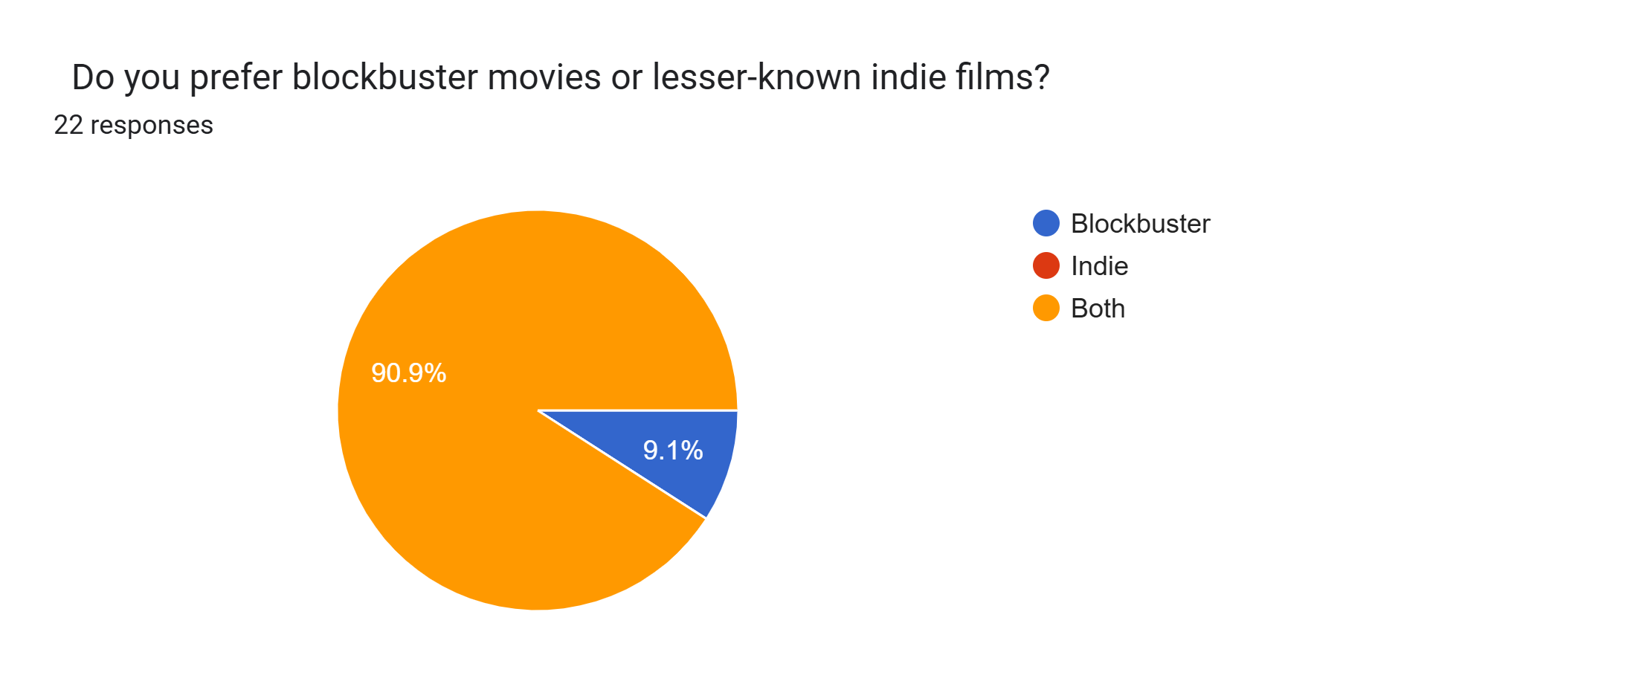
Gathering Requirements
Google survey Insights:

Slide 6
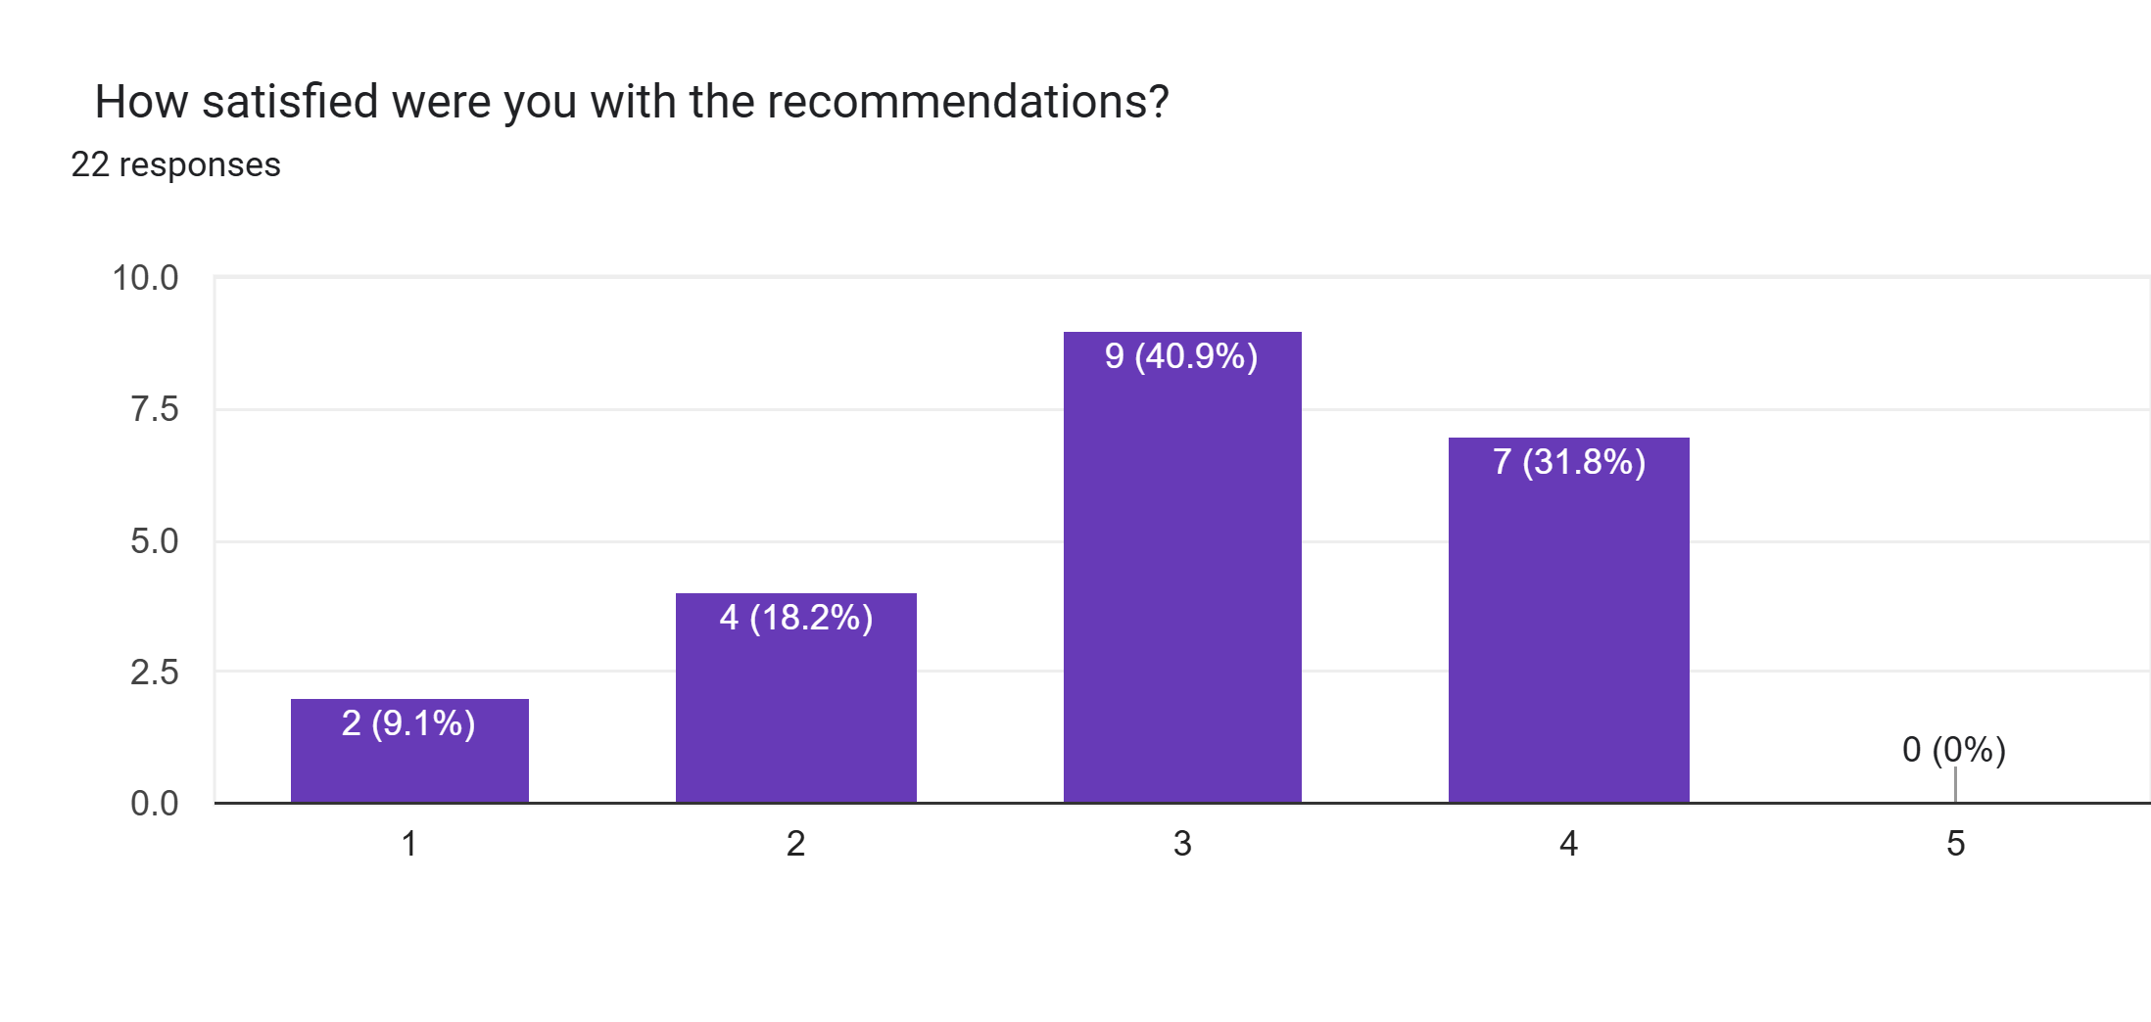
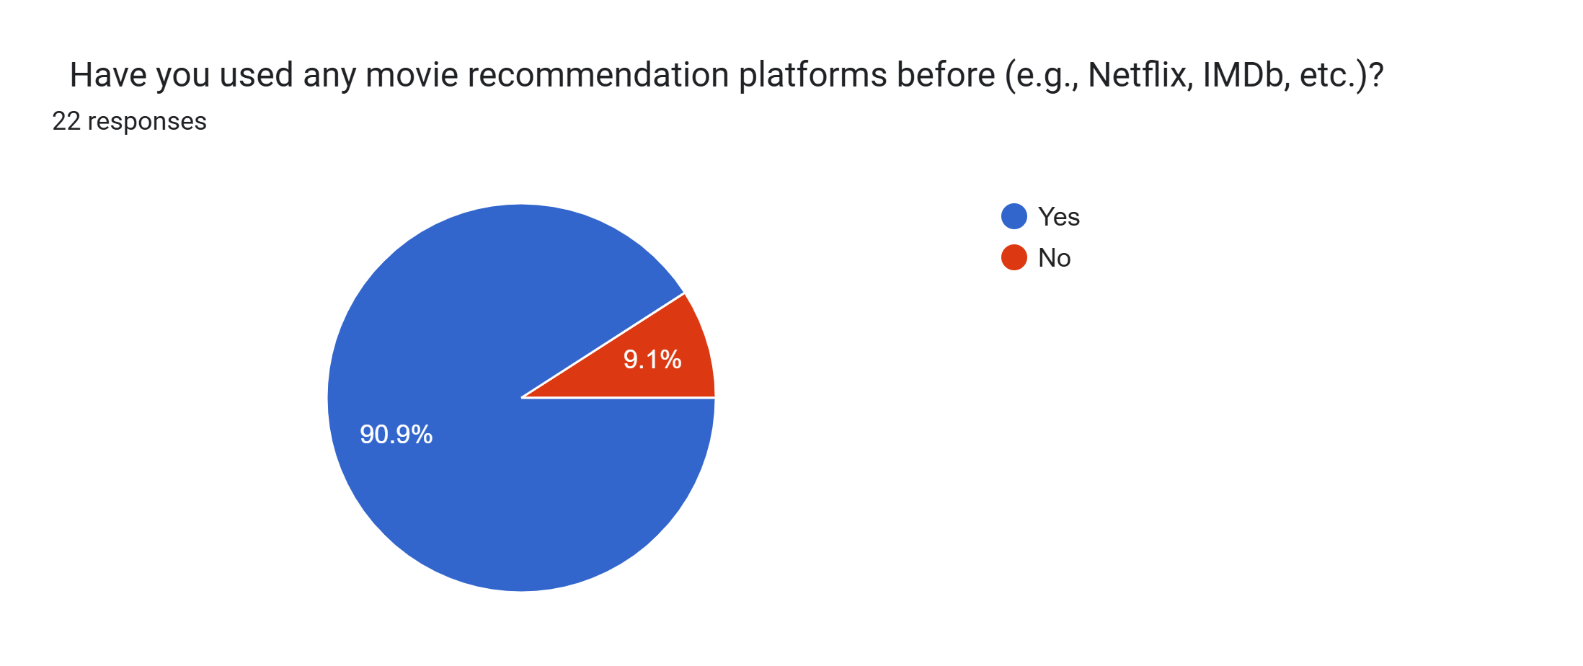
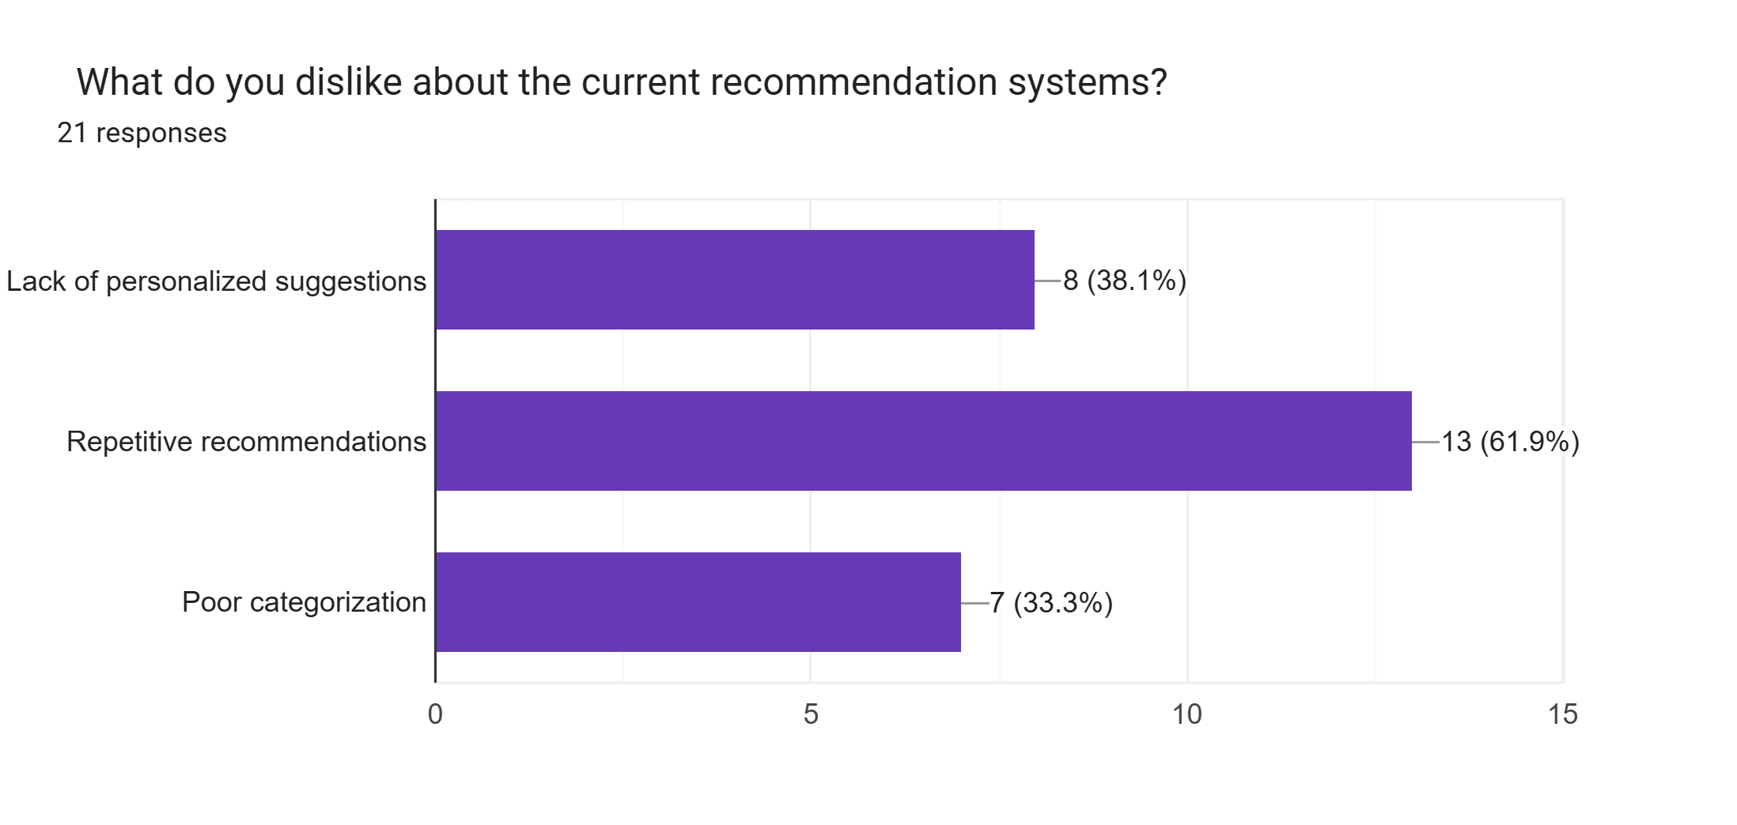
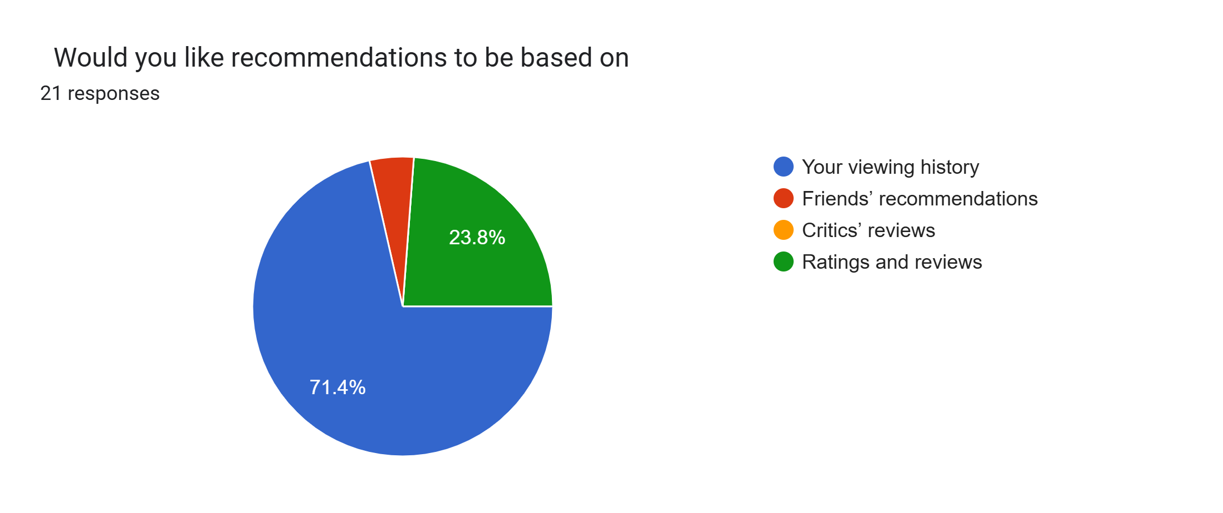
Gathering Requirements

Slide 7
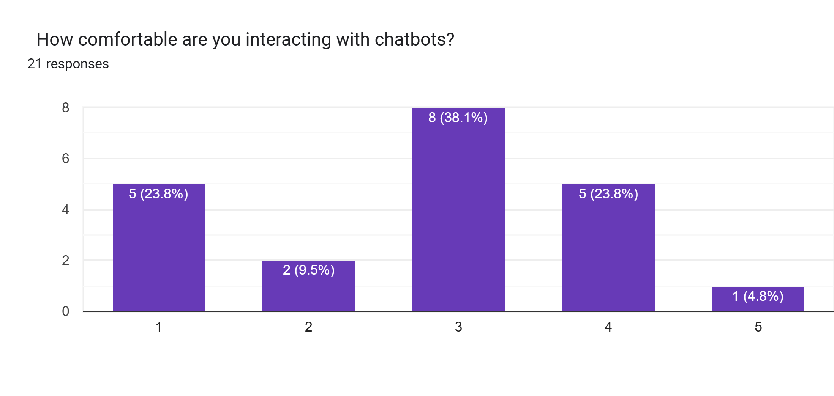
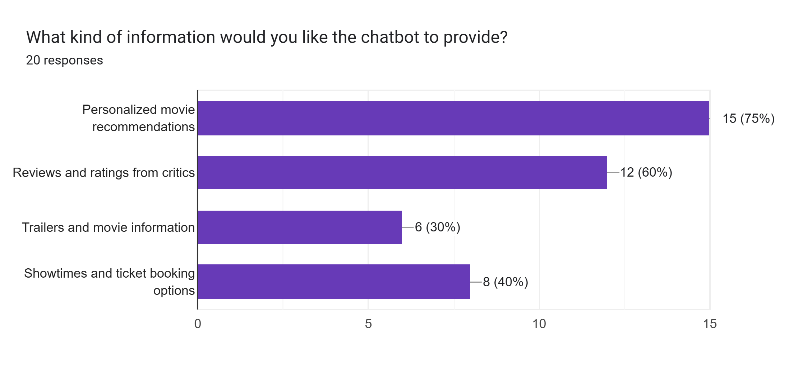
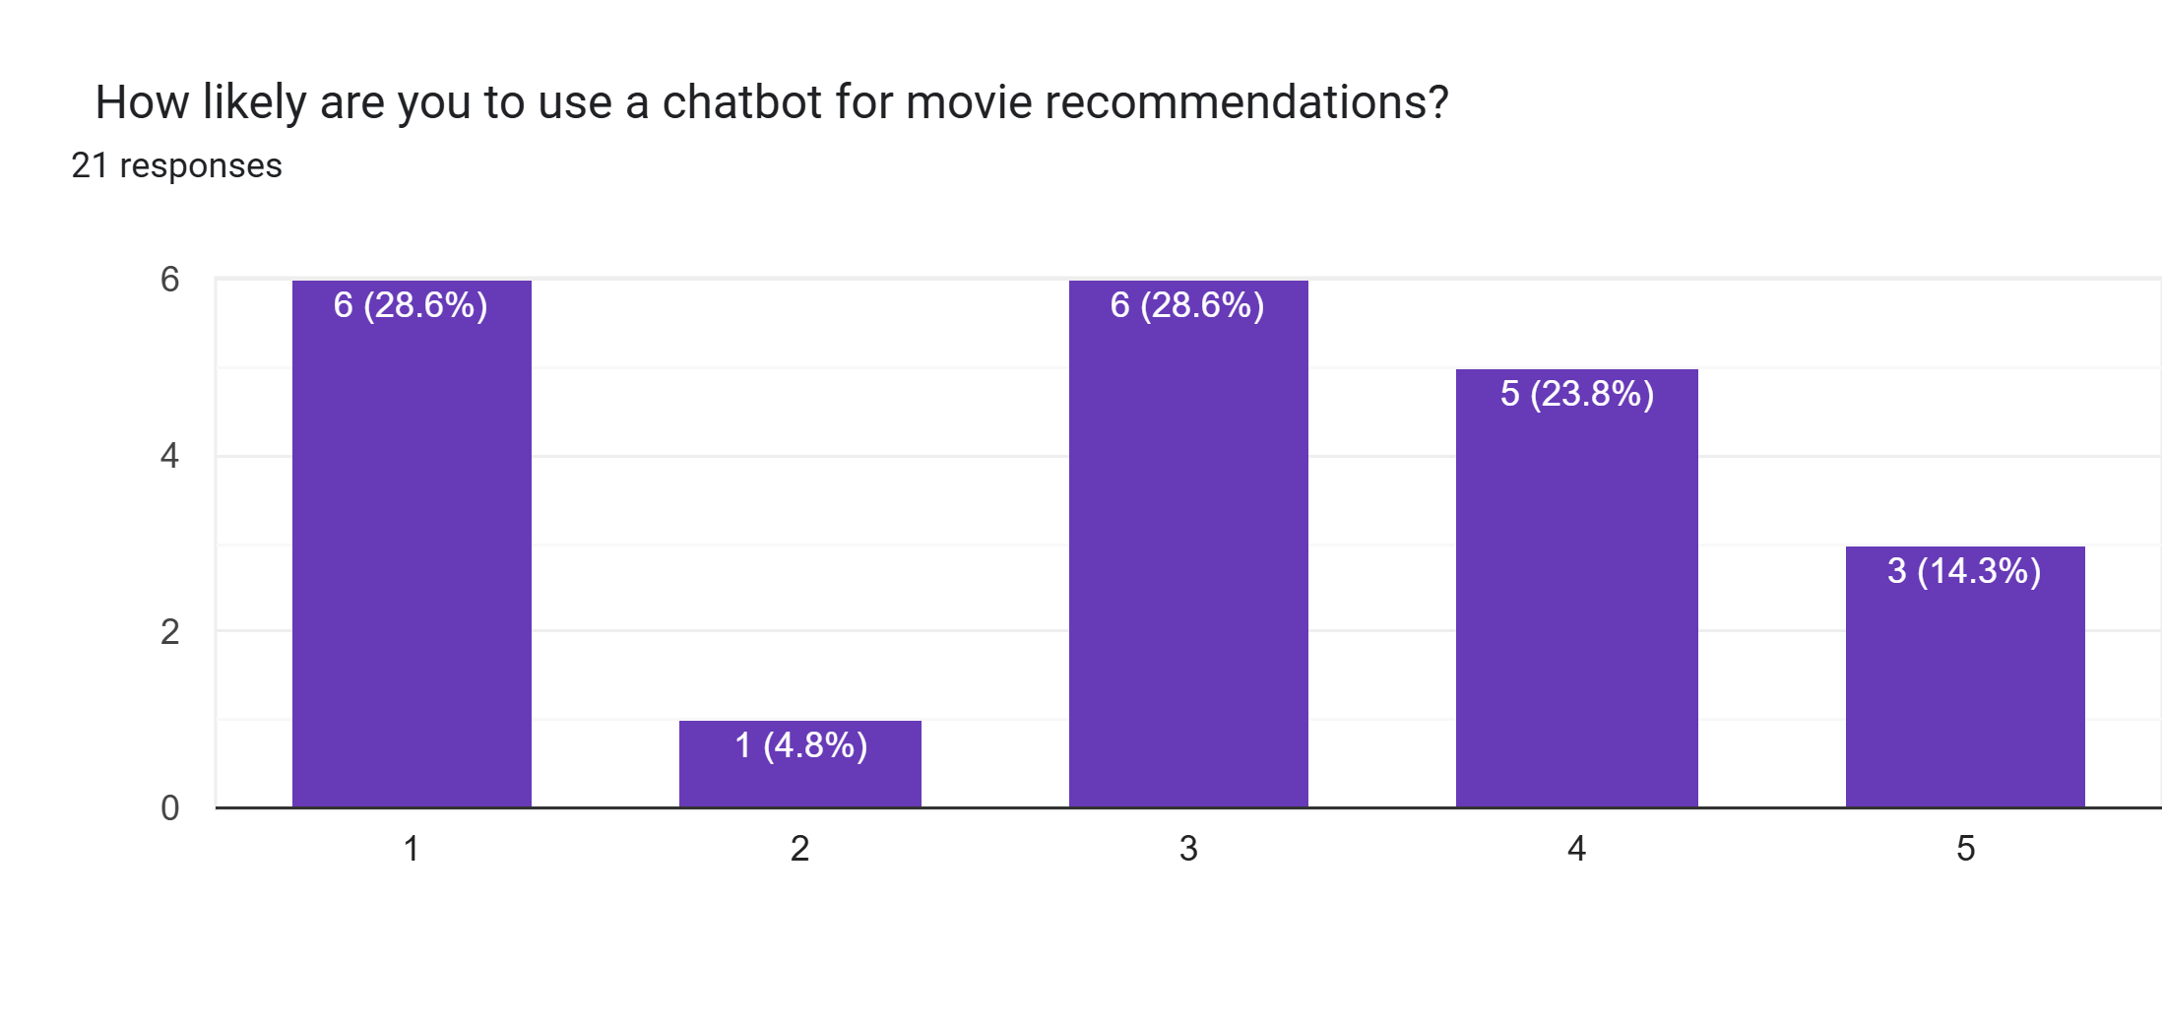
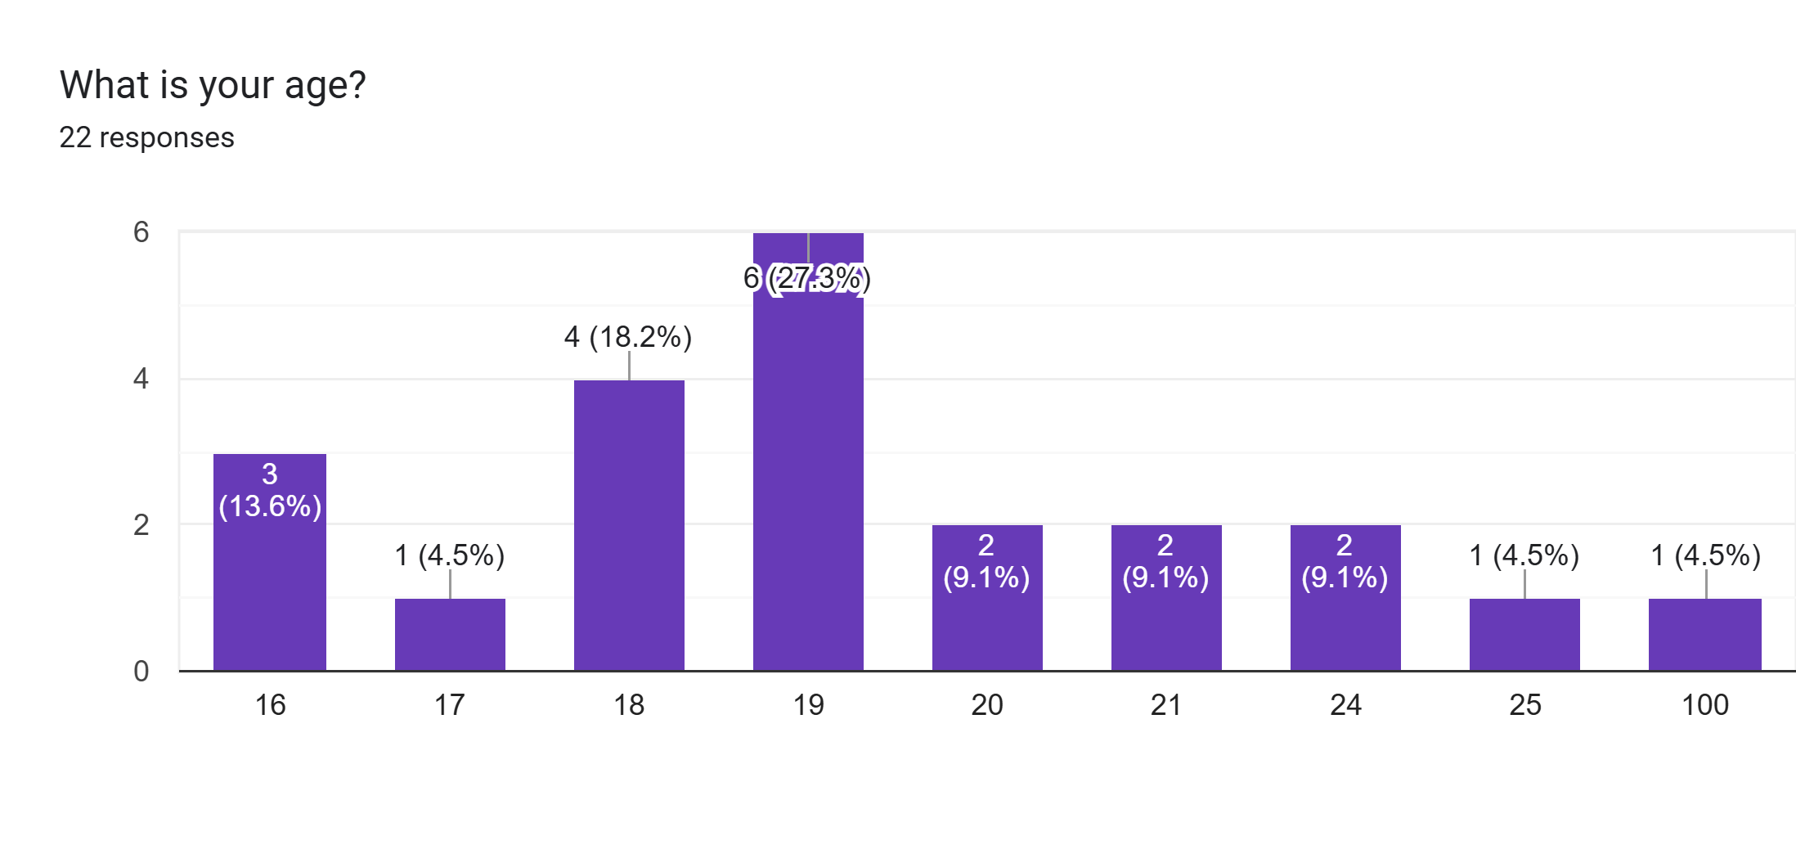
Gathering Requirements

Slide 8
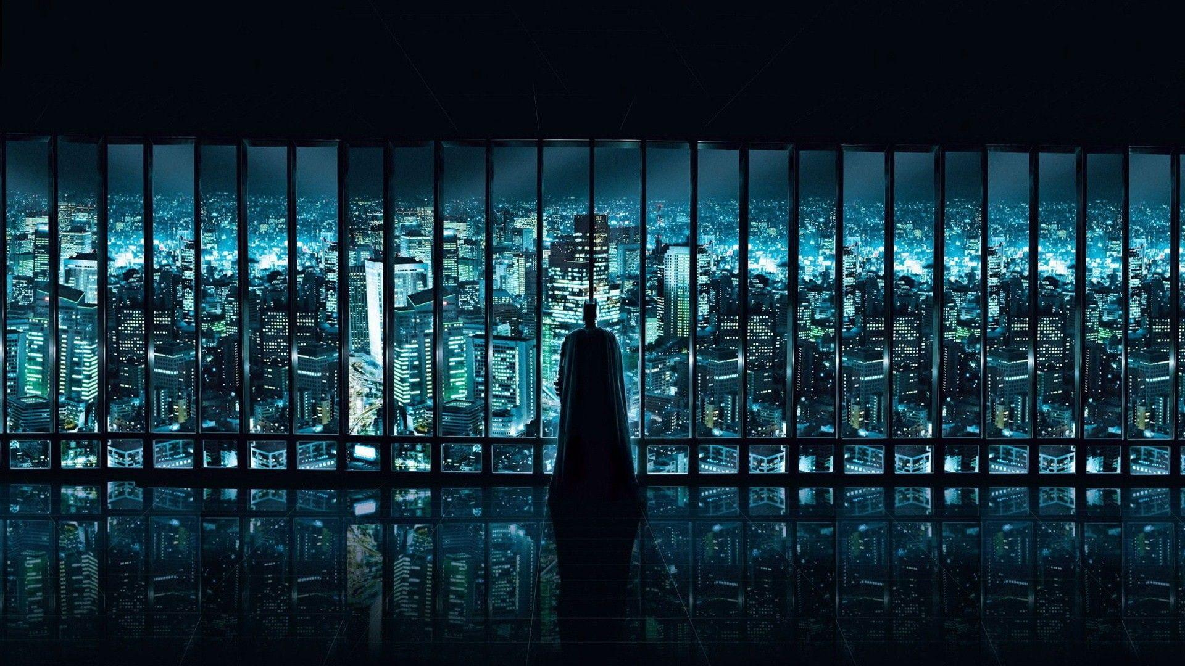
Categorizing Requirements
Functional:
Recommend movies
aggregate reviews
Non-Functional:
Handle 1,000 users
<2s response time
Business
Boost engagement by 20%
provide genre/trend insights.
Technical
API integration
web/mobile compatibility
search functionality
user ratings.
secure data storage.
natural language processing.

Slide 9

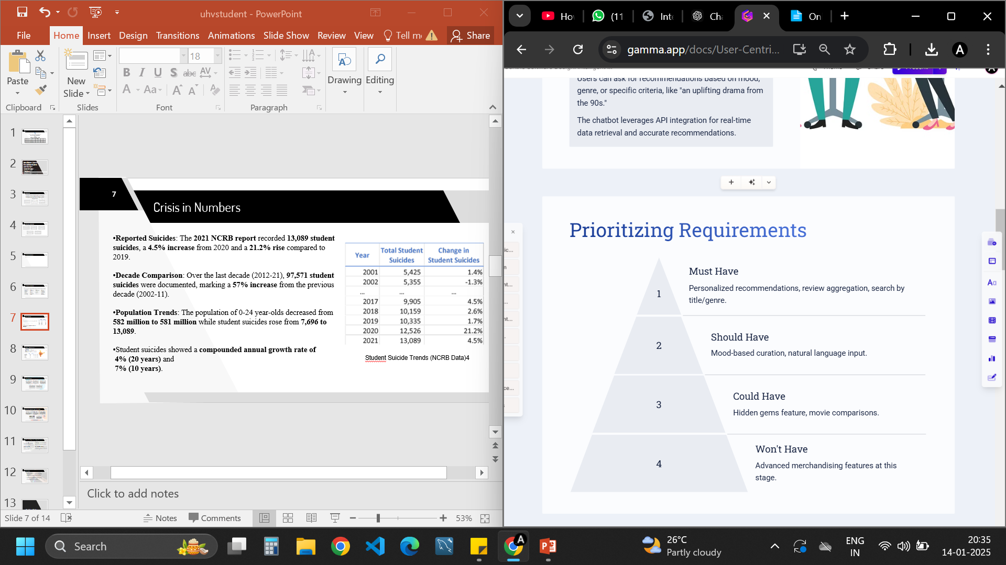
Prioritizing Requirements

Slide 10
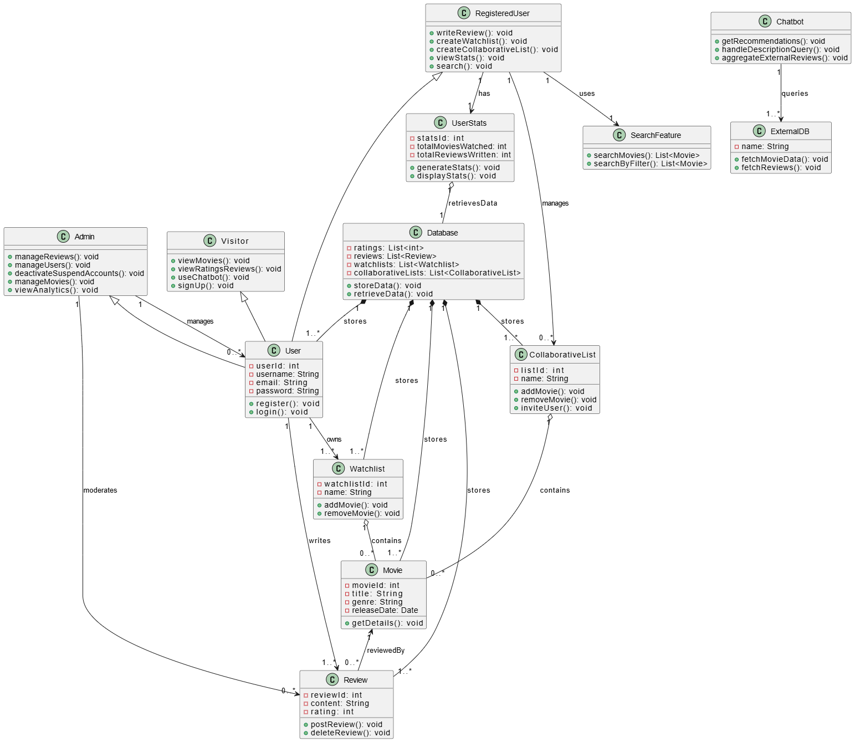
Analyzing and Modeling Requirements
Class Diagram

Slide 11

Real-Life Application
Enhanced User Experience:
The chatbot provides a personalized and engaging movie discovery experience.
Increased Engagement
Businesses can integrate the chatbot into their platforms to drive user engagement and loyalty.
Business Value
The chatbot can improve user satisfaction, generate revenue, and foster brand loyalty.

Slide 12
Conclusion
Our Movie Recommendation Chatbot is designed to make your movie discovery journey enjoyable and personalized.
By understanding your preferences—whether it's a specific genre, mood, or era—we provide tailored suggestions just for you.
Aggregating reviews from trusted sources like IMDb and Rotten Tomatoes, we ensure you have all the information you need.

Slide 13
THANK YOU!

Slide 14
References
https://docs.langflow.org/
https://docs.datastax.com/en/astra-db-serverless/index.html

